Slide 1
Customer Retention

Slide 2
Problem Statement
E-retail factors for customer activation and retention: A case study from Indian e-commerce customers

Slide 3
Introduction
Customer satisfaction has emerged as one of the most important factors that guarantee the success of online store; it has been posited as a key stimulant of purchase, repurchase intentions and customer loyalty. A comprehensive review of the literature, theories and models have been carried out to propose the models for customer activation and customer retention. Five major factors that contributed to the success of an e-commerce store have been identified as: service quality, system quality, information quality, trust and net benefit. The research furthermore investigated the factors that influence the online customers repeat purchase intention. The combination of both utilitarian value and hedonistic values are needed to affect the repeat purchase intention (loyalty) positively. The data is collected from the Indian online shoppers. Results indicate the e-retail success factors, which are very much critical for customer satisfaction.

Slide 4
Steps, EDA and Visualizations

Slide 5
Extracting the datasheet and saving into a dataframe
The dataframe consists of the following 71 columns (questions asked to customers to understand their requirements, experiences and the efficiency of various online sites]-

Slide 6
Gender of respondent
How old are you
Which city do you shop online from
What is the Pin Code of where you shop online from
Since How Long You are Shopping Online
How many times you have made an online purchase in the past 1 year
How do you access the internet while shopping on-line
Which device do you use to access the online shopping
What is the screen size of your mobile device
What is the operating system (OS) of your device
What browser do you run on your device to access the website
Which channel did you follow to arrive at your favorite online store for the first time
After first visit, how do you reach the online retail store
How much time do you explore the e- retail store before making a purchase decision
What is your preferred payment Option
How frequently do you abandon (selecting an items and leaving without making payment) your shopping cart
Why did you abandon the “Bag”, “Shopping Cart
The content on the website must be easy to read and understand
Information on similar product to the one highlighted is important for product comparison
Complete information on listed seller and product being offered is important for purchase decision.
All relevant information on listed products must be stated clearly
Ease of navigation in website
Loading and processing speed
User friendly Interface of the website
Convenient Payment methods
All relevant information on listed products must be stated clearly
Ease of navigation in website
Loading and processing speed
User friendly Interface of the website
Convenient Payment methods

Slide 7
Trust that the online retail store will fulfill its part of the transaction at the stipulated time
Empathy (readiness to assist with queries) towards the customers
Being able to guarantee the privacy of the customer
Responsiveness, availability of several communication channels (email, online rep, twitter, phone etc.)
Online shopping gives monetary benefit and discounts
Enjoyment is derived from shopping online
Shopping online is convenient and flexible
Return and replacement policy of the e-tailer is important for purchase decision
Gaining access to loyalty programs is a benefit of shopping online
Displaying quality Information on the website improves satisfaction of customers
User derive satisfaction while shopping on a good quality website or application
Net Benefit derived from shopping online can lead to users satisfaction
User satisfaction cannot exist without trust
Offering a wide variety of listed product in several category
Provision of complete and relevant product information
Monetary savings
The Convenience of patronizing the online retailer
Shopping on the website gives you the sense of adventure
Shopping on your preferred e-tailer enhances your social status
You feel gratification shopping on your favorite e-tailer
Shopping on the website helps you fulfill certain roles
Getting value for money spent
From the following, tick any (or all) of the online retailers you have shopped from

Slide 8
Easy to use website or application
Visual appealing web-page layout
Wild variety of product on offer
Complete, relevant description information of products
Fast loading website speed of website and application
Reliability of the website or application
Quickness to complete purchase
Availability of several payment options
Speedy order delivery
Privacy of customers’ information
Security of customer financial information
Perceived Trustworthiness
Presence of online assistance through multi-channel
Longer time to get logged in (promotion, sales period)
Longer time in displaying graphics and photos (promotion, sales period)
Late declaration of price (promotion, sales period)
Longer page loading time (promotion, sales period)
Limited mode of payment on most products (promotion, sales period)
Longer delivery period
Change in website/Application design
Frequent disruption when moving from one page to another
Website is as efficient as before
Which of the Indian online retailer would you recommend to a friend

Slide 9
Checking the shape of the dataframe-
There are 269 rows and 71 columns (i.e., 269 data entries)
Checking the data type of each column-
All are of object data type except for the pincode column (As the dataframe consists of object data, it will have to be encoded prior any machine model instantiation)
Checking for null values-
There are no null values in the dataframe
Visualizing the data in each column using countplot and couting the values in each column using value_counts-

Slide 10
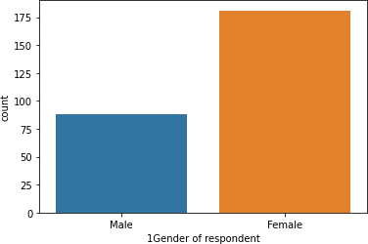
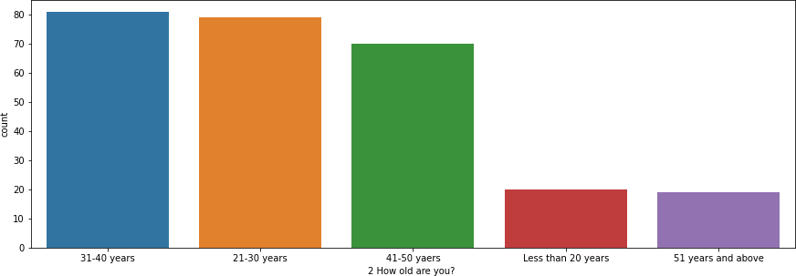
Visualization of responses for each question-
Gender of respondent
There are 181 female respondents and 88 male respondents
[As the majority of the customers are females the e-commerce stores should encourage on female focused products and services more. Further to add more male customers, the stores should add more male oriented products as well]
How old are you
81 respondents belong to 31-40 years age group, 79 respondents belong to 21-
30 years age group, 70 respondents belong to 41-50 years age group, 20 respondents are Less than 20 years of age, 19 respondents are 51 years and
above
[Majority of the customers are young to middle aged people. The e-commerce stores should encourage the purchase from such customers. In addition, it should encourage teen and old aged customers as well]

Slide 11
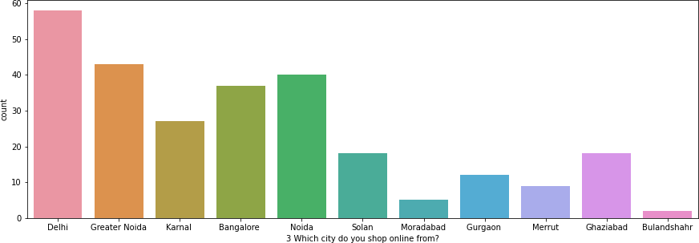
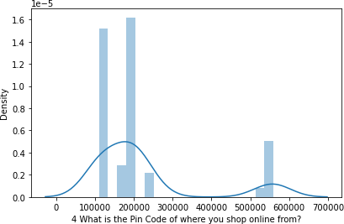
Which city do you shop online from
58 respondents shop online from Delhi, 43 respondents shop online from Grea ter Noida, 40 respondents shop online from Noida, 37 respondents shop online from Bangalore, 27 respondents shop online from Karnal, 18 respondents shop online from Solan, 18 respondents shop online from Ghaziabad, 12 respondent s shop online from Gurgaon, 9 respondents shop online from Merrut, 5 respon dents shop online from Moradabad, 2 respondents shop online from Bulandshahr
[Majority of the purchases are done from Delhi and Noida region.]
What is the Pin Code of where you shop online from
38 respondents shop online from the pincode 201308. This pincode belong to Greater Noida city

Slide 12
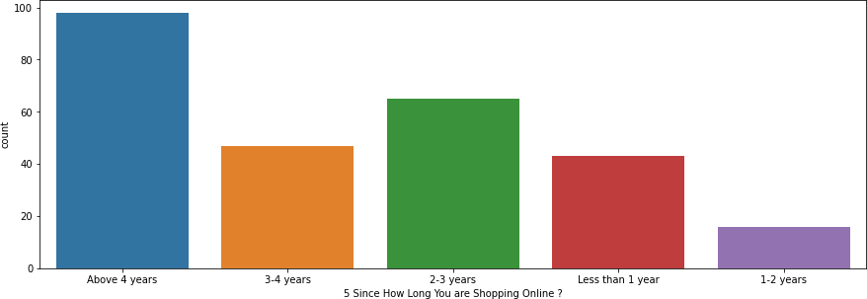
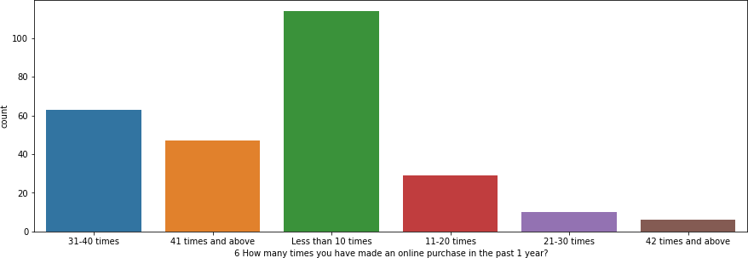
Since How Long You are Shopping Online
98 respondents are shopping online since 4 years, 65 respondents are shopping online from 2-3 years, 47 respondents are shopping online from 3-4 years, 43 respondents are shopping online from less than 1 year, 16 respondent are shopping online from 1-2 years
[Majority of the customers seem to be long term customers, who have been purchasing online for a long time]
How many times you have made an online purchase in the past 1 year
114 respondents have purchased online less than 10 times, 63 respondents have purchased online 31-40 times, 47 respondents have purchased online 41 times and above, 29 respondents have purchased online 11-20 times, 10 respondents have purchased online 21-30 times, 6 respondents have purchased online 42 times and above
[Almost half of the population shops less than 10 times a year, whereas half of the population shops 31-42 times a year.]

Slide 13
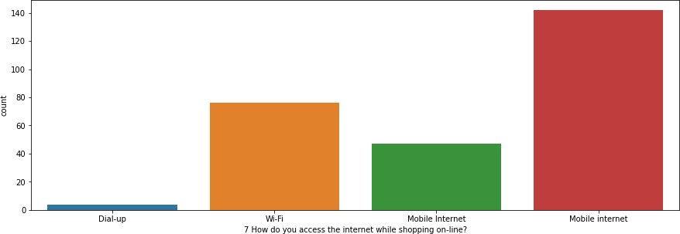
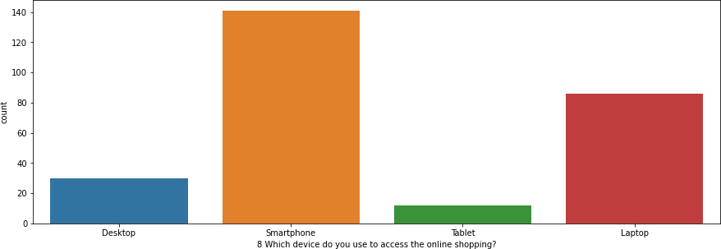
How do you access the internet while shopping on-line
199 respondents use mobile internet while shopping online, 76 respondents us e Wi-Fi while shopping online and 4 respondents use Dial-up while shopping Online
[Majority of the respondents use mobile internet while shopping online. The e-commerce stores can provide mobile internet service deals to enhance their customer connectivity]
Which device do you use to access the online shopping
141 respondents use smartphone while shopping online, 86 respondents use laptop while shopping online, 30 respondents use desktop while shopping online, 12 respondents use tablet while shopping online
[Majority of the customers use smartphone to shop online. The e-commerce stores can provide deals on smartphones to enhance their customer connectivity]

Slide 14
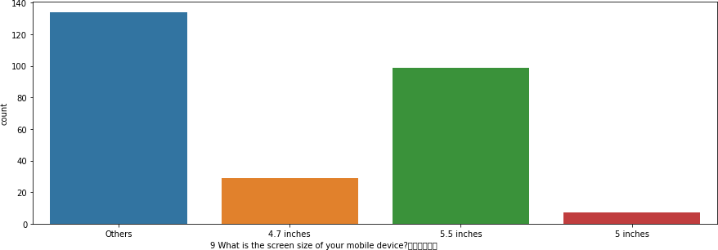
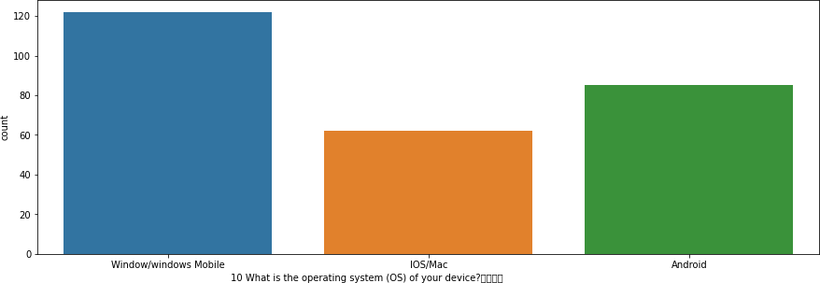
What is the screen size of your mobile device
134 respondents use mobile device with some other screen size, 99 responden ts use 5.5 inch mobile device screen size, 29 respondents use 4.7 inch mobile d evice screen size, 7 respondents use 5 inch mobile device screen size
What is the operating system (OS) of your device
122 respondents use windows mobile, 85 respondents use android device, 62 respondents use IOS/Mac device

Slide 15
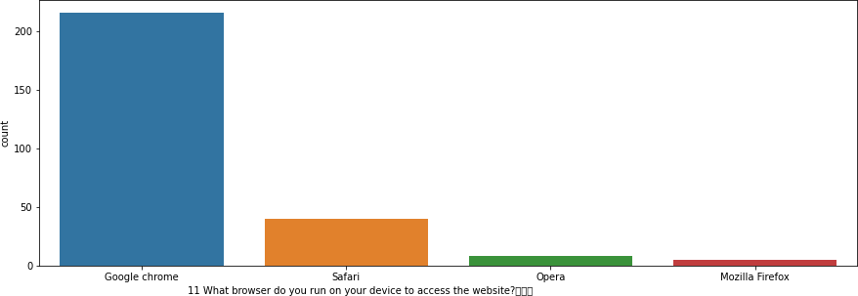
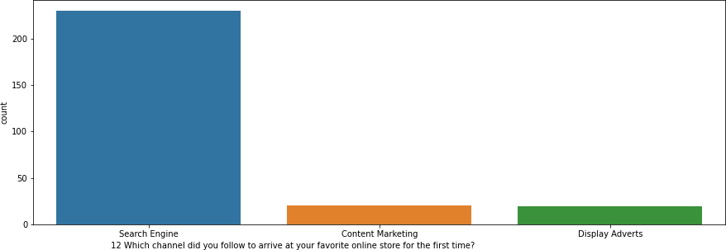
What browser do you run on your device to access the website
216 respondents use Google chrome to access the website, 40 respondents use Safari to access the website, 8 respondents use Opera to access the website, 5 respondents use Mozilla Firefox to access the website
[Majority of the respondents use Google chrome as the browser]
Which channel did you follow to arrive at your favorite online store for the first time
230 respondents use search engine to arrive at their favourite online store for the first time, 20 respondents use content marketing to arrive at their favourite online store for the first time, 19 respondents use display advertisem ents to arrive at their favourite online store for the first time
[Majority of the respondents use search engine (majorly Google chrome) to arrive at their favourite online store for the first time]

Slide 16
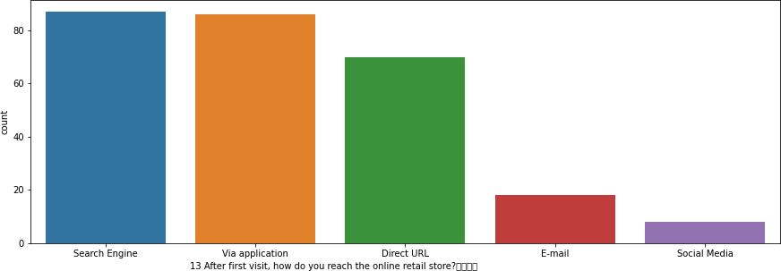
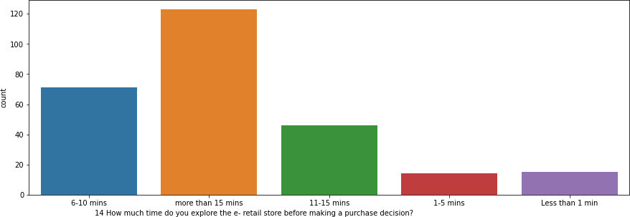
After first visit, how do you reach the online retail store
87 respondents use search engine after first visit to reach online retail store, 8 6 respondents use application after first visit to reach online retail store, 70 respondents use direct url after first visit to reach online retail store, 18 respondents use email after first visit to reach online retail store, 8 respondents use social media after first visit to reach online retail store
[Majority of the respondents use search engine (majorly Google chrome) and the application to reach the online store after the first visit]
How much time do you explore the e- retail store before making a purchase decision
123 respondents take more than 15 mins, 71 take 6-10 mins, 46 take 11-15
mins, 15 take Less than 1 min, 14 take 1-5 mins
[Majority of the respondents take more than 10 minutes to make a purchase decision]

Slide 17
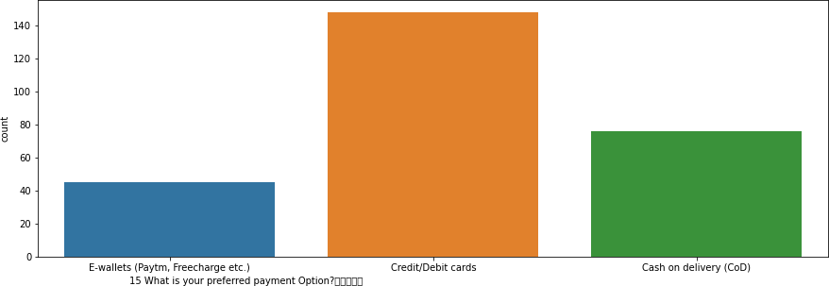
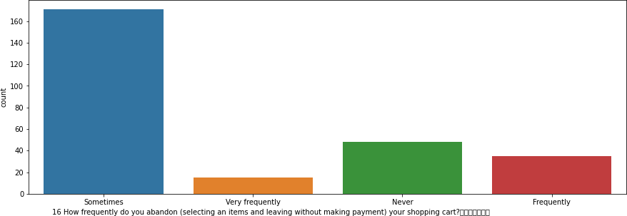
What is your preferred payment Option
148 respondesnts prefer to pay via credit/debit cards, 76 respondents prefer COD, 45 respondents prefer E-wallets (Paytm, Freecharge etc.)
[Majority of the respondents prefer to pay via credit/debit cards]
How frequently do you abandon (selecting an items and leaving without making payment) your shopping cart
171 respondents sometimes abandon their shopping cart, 48 respondents never abandon their shopping cart, 35 respondents frequently abandon their s hopping cart, 15 respondents very frequently abandon their shopping cart
[Majority of the respondents abandon their shopping cart sometimes]

Slide 18
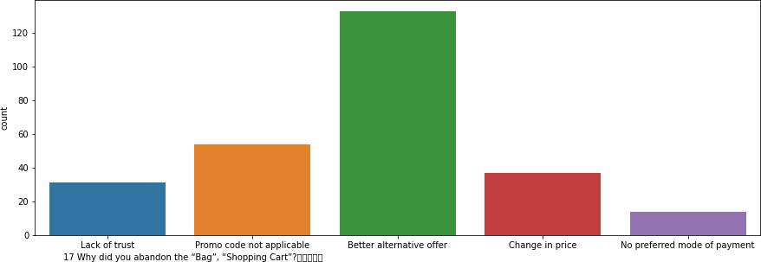
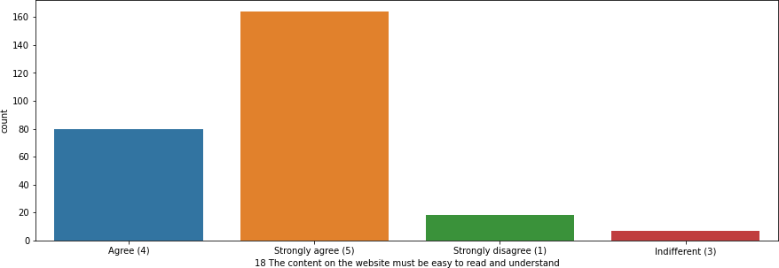
Why did you abandon the “Bag”, “Shopping Cart
133 respondents abandoned their shopping cart because of a Better alternative offer, 54 respondents abandoned their shopping cart because Promo code not applicable, 37 respondents abandoned their shopping cart be cause of Change in price, 31 respondents abandoned their shopping cart because of Lack of trust, 14 respondents abandoned their shopping cart because of No preferred mode of payment
[Majority of the respondents abandoned their shopping cart because of a better alternative offer. The e-commerce stores need to work on the offers they are providing to their existing customers]
The content on the website must be easy to read and understand
164 respondents strongly agree that the content on the website must be easy to read and understand, 80 respondents agree that the content on the website must be easy to read and understand, 18 respondents strongly disagree that the content on the website must be easy to read and understand, 7 respondents are indifferent on this topic
[Majority of the respondents agree that the content on the website must be easy to read and understand]

Slide 19
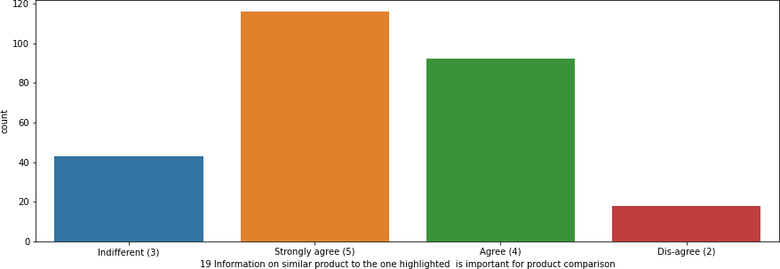
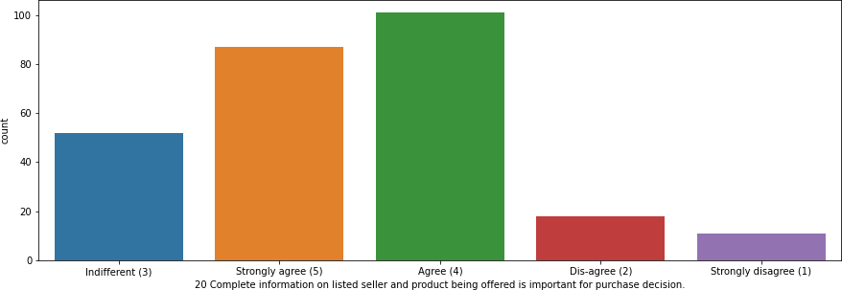
Information on similar product to the one highlighted is important for product comparison
116 respondents strongly agree that Information on similar product to the one highlighted is important for product comparison, 92 respondents agree that In formation on similar product to the one highlighted is important for product comparison, 43 respondents are indifferent on this aspect, 18 respondents disagree that Information on similar product to the one highlighted is important for product comparison
[Majority of the respondents agree that Information on similar product to the o ne highlighted is important for product comparison]
Complete information on listed seller and product being offered is important for purchase decision.
101 respondents agree that complete information on listed seller and product being offered is important for purchase decision, 87 respondents strongly agree that complete information on listed seller and product being offered is important for purchase decision, 52 respondents are indifferent on this aspect,
18 respondents disagree that Complete information on listed seller and
product being offered is important for purchase decision, 11 respondents stron gly disagree that Complete information on listed seller and product being offered is important for purchase decision.
[Majority of the respondents agree that complete information on listed seller a nd product being offered is important for purchase decision]

Slide 20
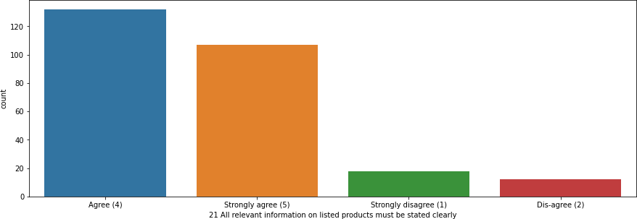
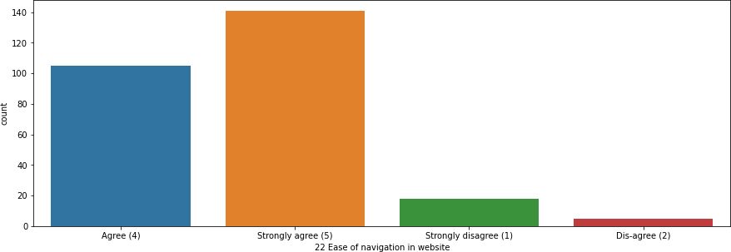
All relevant information on listed products must be stated clearly
132 respondents agree that all relevant information on listed products must be stated clearly, 107 respondents strongly agree that all relevant information on listed products must be stated clearly, 18 respondents strongly disagree that all relevant information on listed products must be stated clearly, 12 respondents disagree that All relevant information on listed products must be stated clearly
[Majority of the respondents agree that all relevant information on listed products must be stated clearly]
Ease of navigation in website
141 respondents strongly agree for ease of navigation in website, 105 respondents agree for ease of navigation in website, 18 respondents strongly disagree for ease of navigation in website, 5 respondents disagree for ease of navigation in website
[Majority of the respondents strongly agree for ease of navigation in website]

Slide 21
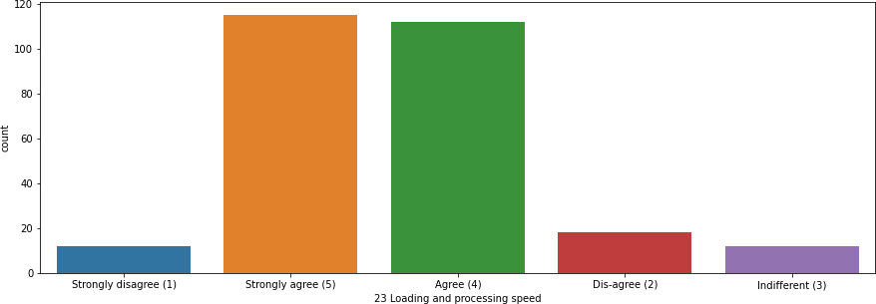
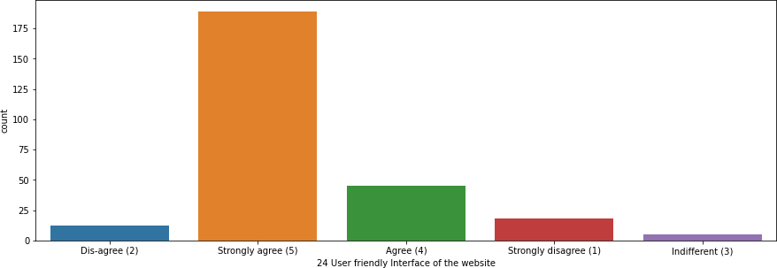
Loading and processing speed
115 respondents strongly agree to loading and processing speed, 112 respondents agree to loading and processing speed, 18 respondents disagree to loading and processing speed, 12 respondents strongly disagree to loading and processing speed, 12 respondents are indifferent to this aspect
[Majority of the respondents agree to loading and processing speed]
User friendly Interface of the website
189 respondents strongly agree to user friendly interface of the website, 45 respondents agree to user friendly interface of the website, 18 respondents strongly disagree to user friendly interface of the website, 12 respondents disagree to user friendly interface of the website, 5 respondents are indifferent to this
[Majority of the respondents agree to user friendly interface of the website]

Slide 22
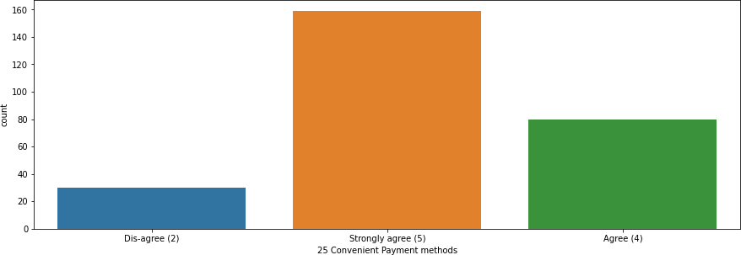
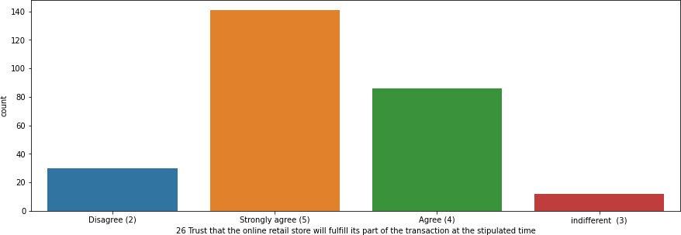
Convenient Payment methods
159 respondents strongly agree to convenient payment methods, 80 respondents agree to convenient payment methods, 30 respondents disagree t o convenient payment methods
[Majority of the respondents agree to convenient payment methods]
Trust that the online retail store will fulfill its part of the transaction at the stipulated time
141 respondents strongly trust that the online retail store will fulfill its part of the transaction at the stipulated time, 86 respondents trust that the online retail store will fulfill its part of the transaction at the stipulated time, 30 respondents does not trust that the online retail store will fulfill its part of the transaction at the stipulated time 12 respondents are indifferent to this matter
[Majority of the respondents strongly trust that the online retail store will fulfill its part of the transaction at the stipulated time]

Slide 23
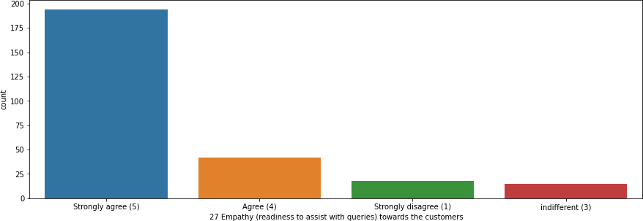
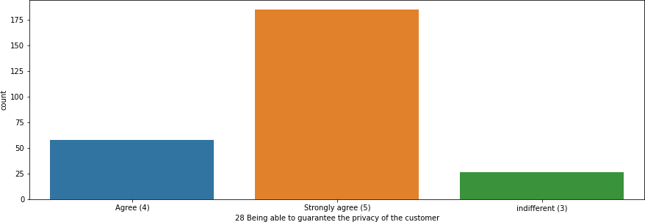
Empathy (readiness to assist with queries) towards the customers
194 respondents strongly agree that the online stores have empathy towards their customers, 42 respondents agree that the online stores have empathy to wards their customers, 18 respondents strongly disagree that the online stores have empathy towards their customers, 15 respondents are indifferent to this
[Majority of the respondents strongly agree that the online stores have empathy towards their customers]
Being able to guarantee the privacy of the customer
185 respondents strongly agree that the online stores are able to guarantee the privacy of their customer, 58 respondents agree that the online stores are able to guarantee the privacy of their customer, 26 respondents re indifferent to this
[Majority of the respondents strongly agree that the online stores are able to guarantee the privacy of their customer]

Slide 24
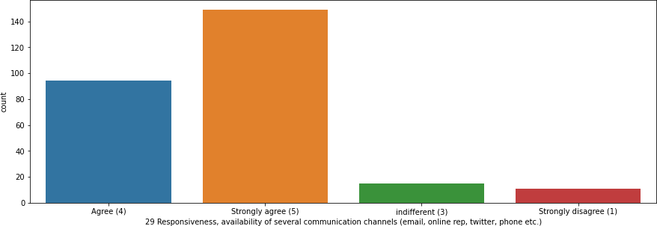
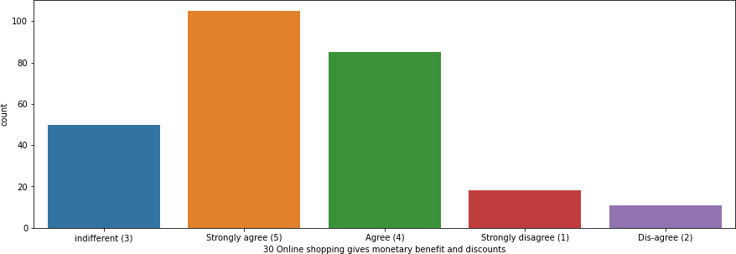
Responsiveness, availability of several communication channels (email, online rep, twitter, phone etc.)
149 respondents strongly agree that the online store is available in several communication channels, 94 respondents agree that the online store is available in several communication channels, 15 are indifferent to this, 11 respondents strongly disagree that the online store is available in several communication channels
[Majority of the respondents agree that the online store is available in several communication channels]
Online shopping gives monetary benefit and discounts
105 respondents strongly agree that online shopping gives monetary benefit and discounts, 85 respondents agree that online shopping gives monetary benefit and discounts, 50 respondents are indifferent to this, 18 respondents strongly disagree that online shopping gives monetary benefit and discounts, 1
1 respondents disagree that online shopping gives monetary benefit and discounts
[Majority of the respondents strongly agree that online shopping gives monetary benefit and discounts]

Slide 25
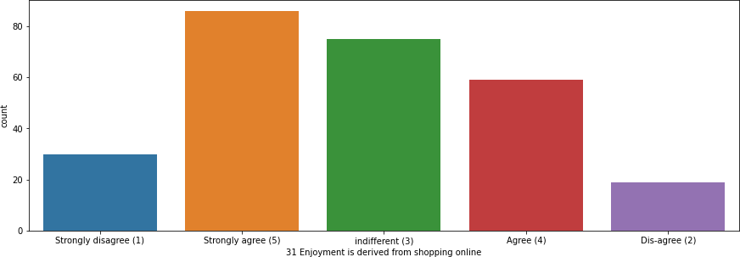
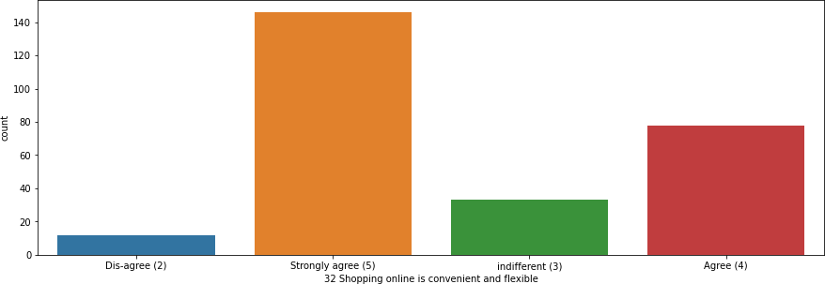
Enjoyment is derived from shopping online
86 respondents strongly agree that online shopping gives enjoyment, 75 respondents are indifferent to this, 59 respondents agree that online shopping gives enjoyment, 30 respondents strongly disagree that online shopping gives enjoyment, 19 respondents disagree that online shopping gives enjoyment
[Almost half of the population agree that online shopping gives enjoyment. The e-commerce stores need to make online shopping a more enjoyable experience for their customers]
Shopping online is convenient and flexible
146 respondents strongly agree that online shopping is convenient and flexible
, 78 respondents agree that online shopping is convenient and flexible, 33 respondents are indifferent on this matter, 12 respondents disagree that
online shopping is convenient and flexible
[Majority of the respondents agree that online shopping is convenient and flexible]

Slide 26
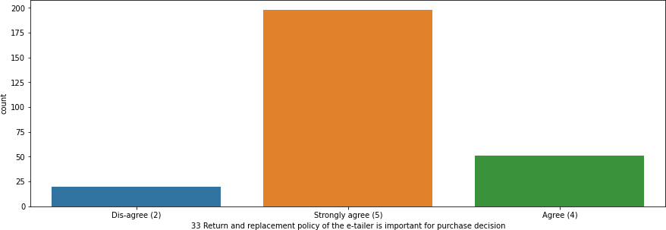
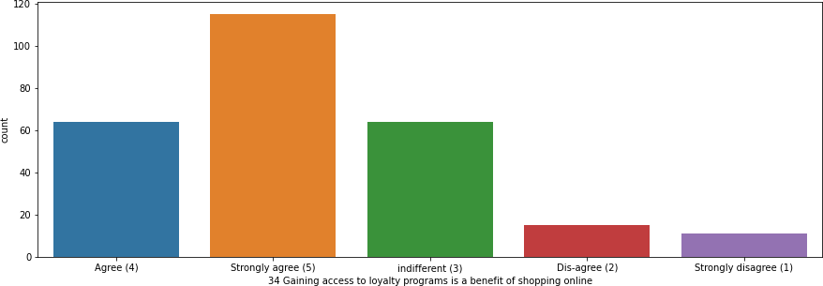
Return and replacement policy of the e-tailer is important for purchase decision
198 respondents strongly agree that return and replacement policy of the e-tailer is important for purchase decision, 51 respondents agree that return a nd replacement policy of the e-tailer is important for purchase decision, 20 respondents disagree that return and replacement policy of the e-tailer is important for purchase decision
[Majority of the respondents agree that return and replacement policy of the e-tailer is important for purchase decision]
Gaining access to loyalty programs is a benefit of shopping online
115 respondents strongly agree that gaining access to loyalty programs is a benefit of shopping online, 64 respondents agree that gaining access to loyalty programs is a benefit of shopping online, 64 respondents are indifferent to this matter, 15 respondents disagree that gaining access to loyalty programs is a be nefit of shopping online, 11 respondents strongly disagree that gaining access to loyalty programs is a benefit of shopping online
[Majority of respondents strongly agree that gaining access to loyalty program s is a benefit of shopping online. Hence e-commerce stores should provide m ore loyalty programs]

Slide 27
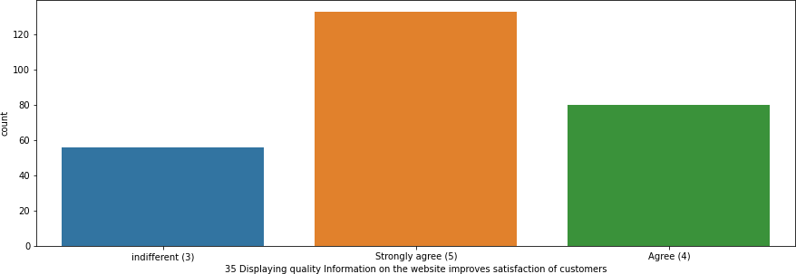
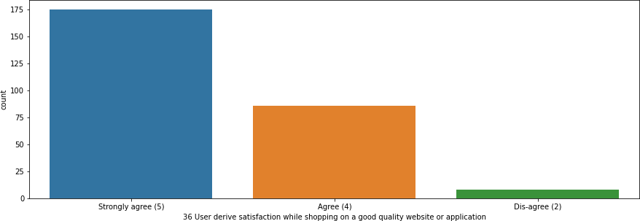
Displaying quality Information on the website improves satisfaction of customers
133 respondents strongly agree that displaying quality information on the website improves satisfaction of customers, 80 respondents agree that displaying quality information on the website improves satisfaction of customers, 56 respondents are indifferent on this
[Majority of respondents agree that displaying quality information on the websi te improves satisfaction of customers]
User derive satisfaction while shopping on a good quality website or application
175 respondents strongly agree that they derive satisfaction while shopping on a good quality website or application, 86 respondents agree that they derive satisfaction while shopping on a good quality website or application, 8 respondents disagree that they derive satisfaction while shopping on a good quality website or application
[Majority of the respondents agree that they derive satisfaction while shopping on a good quality website or application. Hence e-commerce stores should have good quality website/application]

Slide 28
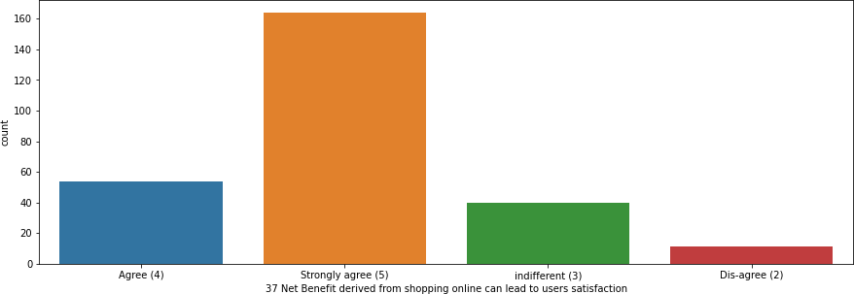
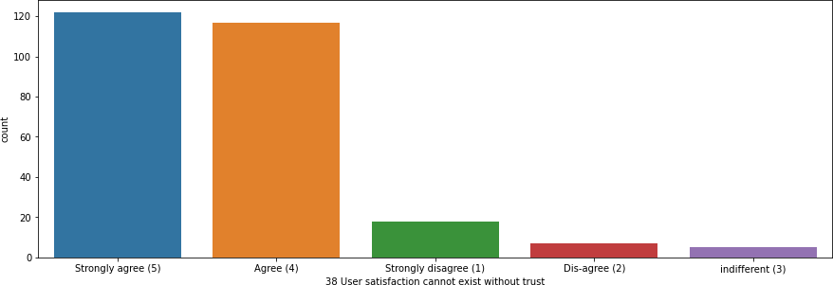
Net Benefit derived from shopping online can lead to users satisfaction
164 respondents strongly agree that the net benefit they derive from shopping online leads to their user satisfaction, 54 respondents agree that the net benefit they derive from shopping online leads to their user satisfaction, 40 respondents are indifferent on this matter, 11 respondents disagree that the net benefit they derive from shopping online leads to their user satisfaction
[Majority of the respondents strongly agree that the net benefit they derive from shopping online leads to their user satisfaction]
User satisfaction cannot exist without trust
122 respondents strongly agree that user satisfaction cannot exist without trust, 117 respondents agree that user satisfaction cannot exist without trust, 18 respondents strongly disagree that user satisfaction cannot exist without trust, 7 respondents disagree that user satisfaction cannot exist without trust, 5 respondents are indifferent on this
[Majority of respondents strongly agree that user satisfaction cannot exist without trust]

Slide 29
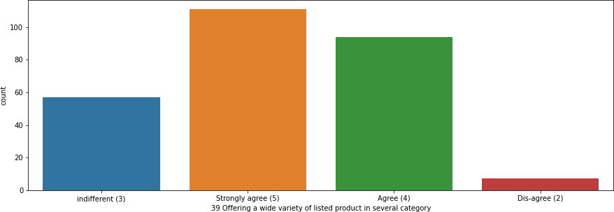
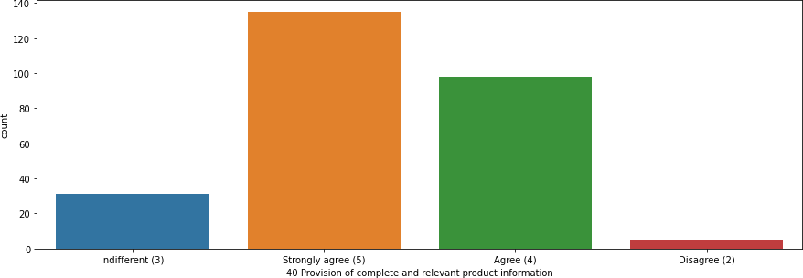
Offering a wide variety of listed product in several category
111 respondents strongly agree upon a wide variety of listed products in several category, 94 respondents agree upon a wide variety of listed products in several category, 57 respondents are indifferent upon this aspect, 7 respondents disagree upon a wide variety of listed products in several category
[Majority of the respondents strongly agree upon a wide variety of listed products in several category. Hence the e-commerce portals should provide a wide variety of products in each category]
Provision of complete and relevant product information
135 respondents strongly agree upon complete and relevant information, 98 respondents agree upon complete and relevant
product product
information, 31 respondents are indifferent on this aspect, 5 respondents disagree upon complete and relevant product information
[Majority of the respondents strongly agree upon complete and relevant product information. Hence the e-commerce stores should provide complete and relevant information for all its products]

Slide 30
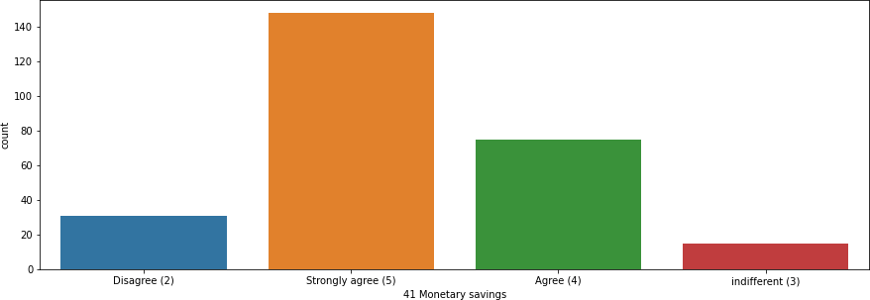
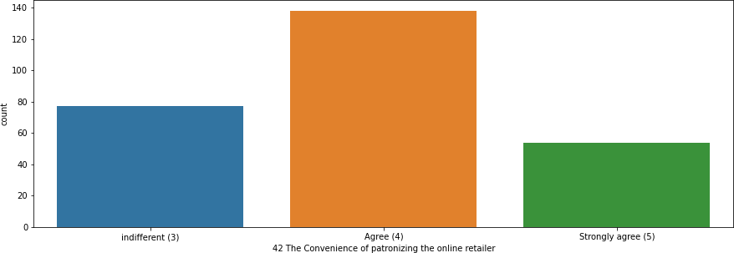
Monetary savings
148 respondents strongly agree that online shopping provides monetary benefits, 75 respondents agree that online shopping provides monetary benefits, 31 respondents disagree that online shopping provides monetary benefits, 15 respondents are indifferent on this aspect
[Majority of the respondents strongly that online shopping provides monetary benefits]
The Convenience of patronizing the online retailer
138 respondents agree upon the convenience of patronizing the online retailer
, 77 respondents are indifferent on this aspect, 54 respondents strongly agree upon the convenience of patronizing the online retailer
[Majority of the respondents agree upon the convenience of patronizing the onl ine retailer]

Slide 31
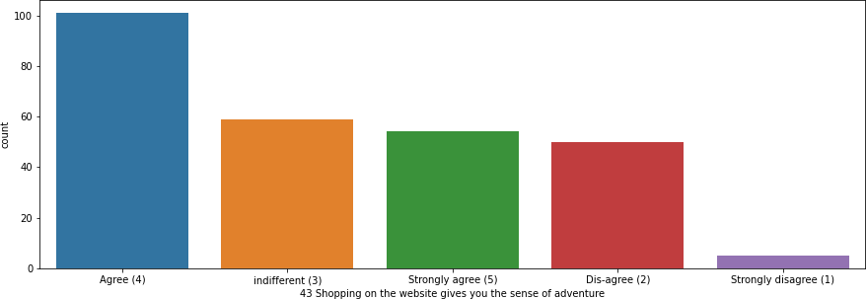
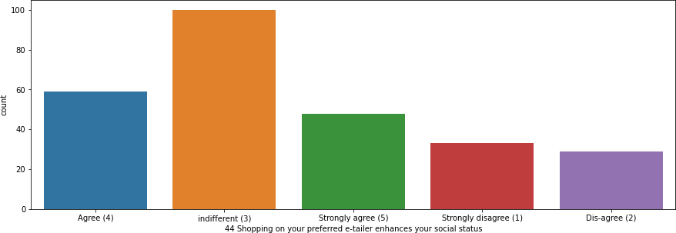
Shopping on the website gives you the sense of adventure
101 respondents agree upon the adventure provided by shopping on the website, 59 respondents are indifferent to this aspect, 54 respondents strongly agree upon the adventure provided by shopping on the website, 50 respondents disagree upon the adventure provided by shopping on the website, 5 respondents strongly disagree upon the adventure provided by shopping on the website
[Majority of the respondents agree upon the adventure provided by shopping o n the website]
Shopping on your preferred e-tailer enhances your social status
100 respondents are indifferent to this aspect, 59 respondents agree that shopping on your preferred e-commerce site enhances social status, 48 respondents strongly agree that shopping on your preferred e-commerce site enhances social status, 33 respondents strongly disagree that shopping on your preferred e-commerce site enhances social status, 29 respondents disagree that shopping on your preferred e-commerce site enhances social status
[Half of the population as indifferent to the idea that shopping on your preferred e-commerce site enhances social status and Half of the population agrees to it. The e-commerce sites need to incorporate such products which will help to boost self-imaging and personality, in turn, enhancing social status]

Slide 32
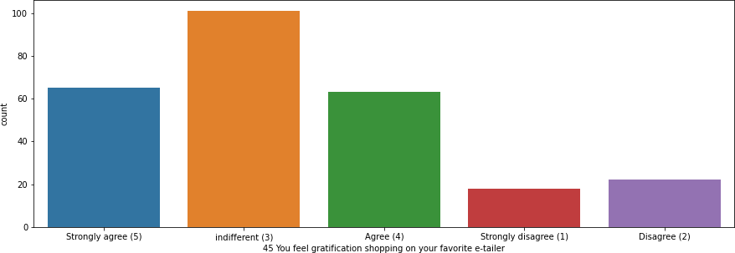
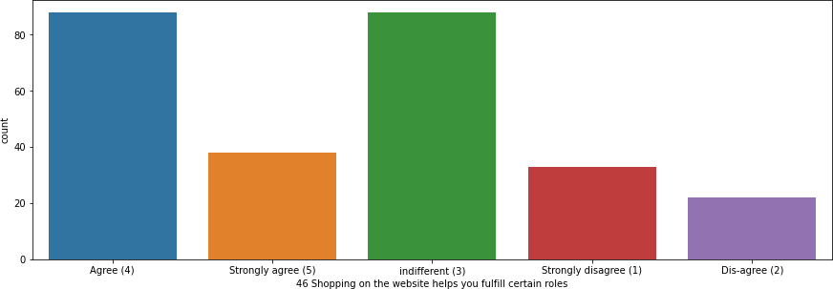
You feel gratification shopping on your favorite e-tailer
101 respondents are indifferent to this aspect, 65 respondents strongly agree upon the gratification they experience while shopping at their favourite e-commerce site, 63 respondents agree upon the gratification they experience while shopping at their favourite e-commerce site, 22 respondents disagree upon the gratification they experience while shopping at their favourite e-commerce site, 18 respondents strongly disagree upon the gratification they experience while shopping at their favourite e-commerce site
[Half of the respondents are indifferent to any gratification they experience while shopping at their favourite e-commerce site, while the other half agree upon the gratification they experience while shopping at their favourite e-commerce site. The e-commerce sites need to earn the loyalty from their customers]
Shopping on the website helps you fulfill certain roles
88 respondents agree that online shopping helps them fulfil certain roles, 88 respondents are indifferent to this, 38 respondents strongly agree that online shopping helps them fulfil certain roles, 33 respondents strongly disagree that online shopping helps them fulfil certain roles, 22 respondents disagree that online shopping helps them fulfil certain roles
[For a certain population online shopping helps them to fulfil certain roles]

Slide 33
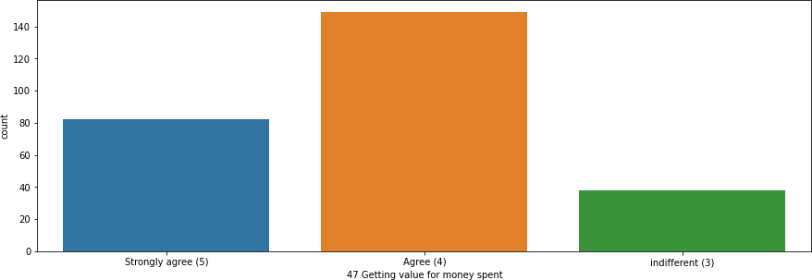
Getting value for money spent
149 respondents agree that they are getting the value spent for the money, 82 respondents strongly agree that they are getting the value spent for the money
, 38 respondents are indifferent to this aspect
[Majority of the respondents agree that they are getting the value spent for the money]

Slide 34
From the following, tick any (or all) of the online retailers you have shopped from
Amazon.in, Flipkart.com, Paytm.com, Myntra.com, Snapdeal.com | 82
Amazon.in, Flipkart.com, Myntra.com, Snapdeal.com | 44
Amazon.in, Flipkart.com | 32
Amazon.in, Flipkart.com, Paytm.com, Snapdeal.com | 29
Amazon.in, Flipkart.com, Snapdeal.com | 27
Amazon.in, Paytm.com, Myntra.com | 20
Amazon.in | 16
Amazon.in, Paytm.com | 12
Amazon.in, Flipkart.com, Paytm.com | 7
[All the respondents have shopped from amazon.in, 221 respondents have shopped from flipkart.com, 150 respondents have shopped from paytm.com, 146 respondents have shopped from myntra.com, 182 respondents have shopped from snapdeal.com]
Online retailers vs number of customers
300
250
200
150
No of customers
100
50
0
Amazon.in Flipkart.com Paytm.com Myntra.com Snapdeal.com
[Amazon.in has the highest number of customers and Myntra.com has the lowe st]

Slide 35
Easy to use website or application
Amazon.in, Flipkart.com, Paytm.com, Myntra.com, Snapdeal.com | 64
Amazon.in, Flipkart.com, Myntra.com, Snapdeal.com | 44
Amazon.in, Flipkart.com | 44
Amazon.in | 29
Amazon.in, Flipkart.com, Paytm.com, Snapdeal.com | 22
Amazon.in, Paytm.com, Myntra.com | 20
Amazon.in, Flipkart.com, Myntra.com | 19
Paytm.com | 12
Flipkart.com | 8
Amazon.in, Paytm.com | 7
[249 respondents find amazon.in to easy to use, 201 respondents find flipkart.com easy to use, 125 respondents find paytm.com easy to use, 147 respondents find myntra.com easy to use, 130 respondents find snapdeal.com e asy to use]
Easy to use
300
250
200
150
No of customers
100
50
0
Amazon.in Flipkart.com Paytm.com Myntra.com Snapdeal.com
[Amazon.in is considered to have an easy to use website as compared to paytm.com]

Slide 36
Visual appealing web-page layout
Amazon.in, Flipkart.com | 87
Amazon.in | 44
Amazon.in, Flipkart.com, Paytm.com, Myntra.com, Snapdeal.com | 36
Amazon.in, Paytm.com, Myntra.com | 20
Amazon.in, Myntra.com | 15
Myntra.com | 15
Flipkart.com, Myntra.com | 15
Amazon.in, Flipkart.com, Myntra.com, Snapdeal.com | 14
Flipkart.com | 12
Amazon.in, Flipkart.com, Paytm.com, Snapdeal.com | 11
[227 respondents find amazon.in web-page layout visually appealing, 175
respondents respondents respondents
find find find
flipkart.com paytm.com myntra.com
web page layout visually appealing, 67 web-page layout visually appealing, 100 web-page layout visually appealing, 61
respondents find snapdeal.com web-page layout visually appealing]
Visually appealing web page layout
250
200
150
No of customers
100
50
0
Amazon.in Flipkart.com Paytm.com Myntra.com Snapdeal.com
[Amazon.in has a visually appealing web-page layout as compared to Snapdeal.com]

Slide 37
Wild variety of product on offer
Amazon.in, Flipkart.com Amazon.in
Amazon.in, Myntra.com
Flipkart.com, Myntra.com Myntra.com
Amazon.in, Flipkart.com, Myntra.com, Snapdeal.com
Amazon.in, Flipkart.com, Paytm.com Flipkart.com
Paytm.com
130
43
20
15
15
14
13
12
7
[220 respondents consider amazon.in to have a wild variety of product on offer, 184 respondents consider flipkart.com to have a wild variety of product on offer, 64 respondents consider myntra.com to have a wild variety of products on offer, 14 respondents consider snapdeal.com to have a wild variety of product on offer, 20 respondents consider paytm.com to have a wild variety of product on offer]
Wild variety of products on offer
250
200
150
No of customers
100
50
0
Amazon.in Flipkart.com Paytm.com Myntra.com Snapdeal.com
[Amazon.in has a wild variety of products on offer as compared to myntra.com]

Slide 38
Complete, relevant description information of products
Amazon.in, Flipkart.com Amazon.in
Amazon.in, Flipkart.com, Paytm.com
Amazon.in, Paytm.com, Myntra.com Amazon.in, Flipkart.com, Myntra.com
Amazon.in, Flipkart.com, Paytm.com, Myntra.com, Snapdeal.com
100
43
24
20
15
15
Amazon.in, Flipkart.com, Myntra.com, Snapdeal.com | 14
Snapdeal.com | 12
Flipkart.com, Snapdeal.com | 11
Flipkart.com | 8
Amazon.in, Flipkart.com, Snapdeal.com | 7
[238 respondents consider amazon.in to have complete, relevant description in formation of products, 194 respondents consider flipkart.com to have complete, relevant description information of products, 59 respondents consider paytm.com to have complete, relevant description information of products, 64 respondents consider myntra.com to have complete, relevant description information of products, 59 respondents consider snapdeal.com to have complete, relevant description information of product]
Complete, Relevant Desciption Information of Product
250
200
150
No of customer
100
50
0
Amazon.in
Flipkart.com
Paytm.com
Myntra.com Snapdeal.com
[Amazon.in provides complete, relevant description information of product as compared to paytm.com and snapdeal.com]

Slide 39
Fast loading website speed of website and application
Amazon.in Amazon.in, Paytm.com
Amazon.in, Flipkart.com, Myntra.com
Amazon.in, Flipkart.com, Paytm.com, Myntra.com, Snapdeal.com Amazon.in, Flipkart.com
Amazon.in, Flipkart.com, Snapdeal.com
Amazon.in, Flipkart.com, Paytm.com
Amazon.in, Flipkart.com, Myntra.com, Snapdeal.com Snapdeal.com
Flipkart.com
51
44
30
30
30
25
25
14
12
8
[249 respondents consider amazon.in to have fast loading website and application, 99 respondents consider paytm.com to have fast loading website and application, 74 respondents consider myntra.com to have fast loading website and application, 162 respondents consider flipkart.com to have fast loading website and application, 81 respondents consider snapdeal.com to have fast loading website and application]
Fast loading website and application
300
250
200
150
No of customer
100
50
0
Amazon.in
Flipkart.com
Paytm.com
Myntra.com Snapdeal.com
[Amazon.in has fast loading website and application as compared to myntra.com]

Slide 40
Reliability of the website or application
Amazon.in | 61
Amazon.in, Flipkart.com | 50
Amazon.in, Flipkart.com, Paytm.com | 36
Amazon.in, Paytm.com, Myntra.com | 35
Amazon.in, Flipkart.com, Snapdeal.com | 18
Myntra.com | 15
Flipkart.com | 15
Amazon.in, Flipkart.com, Myntra.com, Snapdeal.com | 14
Amazon.in, Flipkart.com, Paytm.com, Snapdeal.com | 13
Paytm.com | 12
[227 respondents consider amazon.com to be reliable, 146 respondents consider flipkart.com to be reliable, 96 respondents consider paytm.com to be reliable, 64 respondents consider myntra.com to be reliable, 45 respondents consider snapdeal.com to be reliable]
Reliable
250
200
150
No of customers
100
50
0
Amazon.in Flipkart.com Paytm.com Myntra.com Snapdeal.com
[Amazon.in is considered to be reliable as compared to snapdeal.com]

Slide 41
Quickness to complete purchase
Amazon.com
Amazon.com, Flipkart.com, Paytm.com Amazon.com, Flipkart.com Amazon.com, Flipkart.com, Myntra.com Paytm.com
Amazon.com, Paytm.com, Myntra.com
Amazon.com, Flipkart.com, Paytm.com, Myntra.com, Snapdeal Flipkart.com
Flipkart.com, Myntra.com, Snapdeal
66
47
37
30
25
20
15
15
14
[214 respondents consider purchase at amazon.in to be quick, 158 respondents consider purchase at flipkart.com to be quick, 107 respondents consider purchase at paytm.com to be quick, 79 respondents consider purchase at myntra.com to be quick, 29 respondents consider purchase at snapdeal.com to be quick]
Quickness at purchase
250
200
150
100
50
0
No of customer
Amazon.in
Flipkart.com
Paytm.com
Myntra.com Snapdeal.com
[Amazon.in is considered to have a quick purchase process as compared to snapdeal.com]

Slide 42
Availability of several payment options
Amazon.in, Flipkart.com
Amazon.in, Flipkart.com, Myntra.com
Amazon.in, Flipkart.com, Patym.com, Myntra.com, Snapdeal.com Amazon.in
Patym.com, Myntra.com
Amazon.in, Flipkart.com, Myntra.com, Snapdeal.com Amazon.in, Flipkart.com, Snapdeal.com
65
40
39
23
20
19
18
Flipkart.com, Myntra.com, Snapdeal.com | 14
Patym.com | 12
Amazon.in, Patym.com | 11
Flipkart.com | 8
[215 respondents consider amazon.in to provide several payment options, 203 respondents consider flipkart.com to provide several payment options, 132 respondents consider myntra.com to provide several payment options, 82 respondents consider paytm.com to provide several payment options, 90 respondents consider snapdeal.com to provide several payment options]
Several Payment Option
250
200
150
No of customers
100
50
0
Amazon.in Flipkart.com Paytm.com Myntra.com Snapdeal.com
[Amazon.in provides several payment options as compared to myntra.com]

Slide 43
Speedy order delivery
Amazon.in | 107
Amazon.in, Flipkart.com | 82
Amazon.in, Flipkart.com, Snapdeal.com | 36
Amazon.in, Flipkart.com, Myntra.com | 15
Flipkart.com | 15
Flipkart.com, Myntra.com, Snapdeal.com | 14
[240 respondents consider amazon.in has a speedy order delivery, 162 respondents consider flipkart.com has a speedy order delivery, 50 respondents consider snapdeal.com has a speedy order delivery, 29 respondents consider myntra.com has a speedy order delivery]
Speedy Order Delivery
300
250
200
150
No of customers
100
50
0
Amazon.in Flipkart.com Paytm.com Myntra.com Snapdeal.com
[Amazon has speedy order delivery as compared to paytm]

Slide 44
Privacy of customers’ information
Amazon.in
Amazon.in, Flipkart.com
Amazon.in, Flipkart.com, Myntra.com
Amazon.in, Flipkart.com, Paytm.com, Myntra.com, Snapdeal.com Paytm.com
Myntra.com
Amazon.in, Paytm.com Flipkart.com
Amazon.in, Flipkart.com, Myntra.com, Snapdeal.com
Amazon.in, Flipkart.com, Paytm.com Amazon.in, Flipkart.com, Snapdeal.com
71
54
25
24
18
15
15
15
14
11
7
[221 respondents consider amazon.in protects the privacy of customer’s information, 150 respondents consider flipkart.com protects the privacy of customer’s information, 78 respondents consider myntra.com protects the privacy of customer’s information, 68 respondents consider paytm.com protects the privacy of customer’s information, 45 respondents consider snapdeal.com protects the privacy of customer’s information]
Privacy of customers information
250
200
150
100
50
0
Amazon.in Flipkart.com Paytm.com Myntra.com Snapdeal.com
No of customers
[Amazon.in protects the privacy of customer information as compared to snapdeal]

Slide 45
Security of customer financial information
Amazon.in | 51
Amazon.in, Flipkart.com, Paytm.com, Myntra.com, Snapdeal.com | 42
Flipkart.com | 33
Amazon.in, Flipkart.com, Snapdeal.com | 25
Amazon.in, Flipkart.com | 24
Amazon.in, Paytm.com, Myntra.com | 20
Amazon.in, Snapdeal.com | 19
Myntra.com | 15
Paytm.com | 15
Amazon.in, Flipkart.com, Myntra.com, Snapdeal.com | 14
Amazon.in, Flipkart.com, Paytm.com | 11
[206 respondents consider their financial information secure with amazon.in, 149 respondents consider their financial information secure with flipkart.com, 88 respondents consider their financial information secure with paytm.com, 91 respondents consider their financial information secure with myntra.com, 100 respondents consider their financial information secure with snapdeal.com]
Security of financial information
250
200
150
No of customer
100
50
0
Amazon.in Flipkart.com Paytm.com Myntra.com Snapdeal.com
[Amazon.in secures customers financial information as compared to paytm.com]

Slide 46
Perceived Trustworthiness
Amazon.in
Amazon.in, Flipkart.com, Snapdeal.com Amazon.in, Myntra.com
Amazon.in, Flipkart.com
Flipkart.com
Amazon.in, Flipkart.com, Myntra.com, Snapdeal.com Myntra.com
Amazon.in, Flipkart.com, Paytm.com, Myntra.com, Snapdeal.com
Amazon.in, Flipkart.com, Paytm.com
76
36
35
31
27
25
15
13
11
[227 respondents consider amazon.in trustworthy, 143 respondents consider flipkart.com trustworthy, 74 respondents consider snapdeal.com trustworthy, 88 respondents consider myntra.com trustworthy, 24 respondents consider paytm.com trustworthy]
Trustworthy
250
200
150
100
50
0
No of customer
Amazon.in
Flipkart.com
Paytm.com
Myntra.com
Snapdeal.com
[Amazon.in is considered trustworthy as compared to paytm.com]

Slide 47
Presence of online assistance through multi-channel
Amazon.in, Flipkart.com, Myntra.com, Snapdeal Amazon.in
Amazon.in, Flipkart.com
Amazon.in, Snapdeal Myntra.com
Amazon.in, Flipkart.com, Myntra.com
Amazon.in, Myntra.com
Amazon.in, Flipkart.com, Paytm.com Paytm.com
Flipkart.com
61
60
39
26
20
15
15
13
12
8
[229 respondents consider amazon.in to have online assistance through multi- channel, 136 respondents consider flipkart.com to have online assistance through multi-channel, 111 respondents consider myntra.com to have online assistance through multi-channel, 87 respondents consider snapdeal.com to have online assistance through multi-channel, 25 respondents consider paytm.com to have online assistance through multi-channel]
Online assistance through multi-channel
250
200
150
100
50
0
Amazon.in Flipkart.com Paytm.com Myntra.com Snapdeal.com
No of customers
[Amazon.in provides online assistance through multi-channel, as compared to paytm.com]

Slide 48
Promotion/Sales Period
Longer time to get logged in
Amazon.in
Amazon.in, Flipkart.com Paytm.com
Myntra.com
Amazon.in, Flipkart.com, Snapdeal.com Snapdeal.com
Flipkart.com, Paytm.com
Flipkart.com, Paytm.com, Snapdeal.com Amazon.in, Paytm.com
Flipkart.com
57
38
38
35
29
25
15
13
11
8
[135 respondents experienced longer duration to log in during sale/promotion period in amazon.in, 103 respondents experienced longer duration to log in during sale/promotion period in flipkart.com, 77 respondents experienced long er duration to log in during sale/promotion period in paytm.com, 35 respondents experienced longer duration to log in during sale/promotion period in myntra.com, 67 respondents experienced longer duration to log in during sale/promotion period in snapdeal.com]
Longer time in displaying graphics and photos (promotion, sales period)
Amazon.in, Flipkart.com | 60
Amazon.in | 39
Myntra.com | 35
Snapdeal.com | 34
Myntra.com, Snapdeal.com | 25
Flipkart.com, Snapdeal.com | 19
Paytm.com | 15
Flipkart.com | 15
Amazon.in, Myntra.com, Snapdeal.com | 14
Amazon.in, Paytm.com | 13
[126 respondents faced longer time in displaying graphics and photos in amazo n.in, 73 respondents faced longer time in displaying graphics and photos in flipk art.com, 74 respondents faced longer time in displaying graphics and photos in myntra.com, 92 respondents faced longer time in displaying graphics and phot os in snapdeal.com, 28 respondents faced longer time in displaying graphics an d photos in paytm.com]

Slide 49
Late declaration of price (promotion, sales period)
Myntra.com | 75
Paytm.com | 52
snapdeal.com | 41
Flipkart.com | 38
Amazon.in | 38
Amazon.in, Paytm.com | 13
Paytm.com, snapdeal.com | 7
Amazon.in, Flipkart.com | 5
[56 respondents faced late declaration of price in amazon.in, 75 respondents faced late declaration of price in myntra.com, 72 respondents faced late declaration of price in paytm.com, 48 respondents faced late declaration of price in snapdeal.com, 43 respondents faced late declaration of price in flipkart. com]
Longer page loading time (promotion, sales period)
Myntra.com | 61
Paytm.com | 59
Flipkart.com | 32
Snapdeal.com | 23
Amazon.in, Flipkart.com | 18
Amazon.in | 16
Paytm.com, Snapdeal.com | 15
Amazon.in, Snapdeal.com | 14
Amazon.in, Paytm.com | 13
Flipkart.com, Snapdeal.com | 11
Amazon.in, Paytm.com, Myntra.com | 7
[68 respondents faced longer page loading time in myntra.com, 94 respondents faced longer page loading time in paytm.com, 61 respondents faced longer page loading time in flipkart.com, 63 respondents faced longer page loading time in snapdeal.com, 68 respondents faced longer page loading time in amazo n.in]

Slide 50





Limited mode of payment on most products
Snapdeal.com | 87
Amazon.in | 62
Flipkart.com | 31
Amazon.in, Flipkart.com | 29
Paytm.com | 25
Paytm.com, Snapdeal.com | 15
Amazon.in, Paytm.com | 13
Myntra.com, Snapdeal.com | 7
[109 respondents experienced limited mode of payment in snapdeal.com, 104 r espondents experienced limited mode of payment in amazon.in, 60 respondent s experienced limited mode of payment in flipkart.com, 53 respondents experie nced limited mode of payment in paytm.com, 7 respondents experienced limite d mode of payment in myntra.com]
Promotion/Sales Period
160
140
120
100
80
60
40
Longer duration to log in
Longer time in displaying graphics and photos
Late Declaration of Price
20
0
Longer page loading time
Limited Mode of Payment
[Amazon.in experiences long duration to log in during sales/promotion period] [Amazon.in experiences longer time in displaying graphics and photos during sa les/promotion period]
[Paytm.com and Myntra.com experience late declaration of price during sales/ promotion period]
[Paytm.com experience longer page loading time] [Snapdeal.com experienced limited mode of payment]

Slide 51
Longer delivery period
Paytm.com | 72
Snapdeal.com | 64
Flipkart.com | 44
Amazon.in | 37
Paytm.com, Snapdeal.com | 26
Myntra.com | 26
[98 respondents face long delivery period in paytm.com, 90 respondents face long delivery period in snapdeal.com, 44 respondents face long delivery period in flipkart.com, 37 respondents face long delivery period in amazon.in, 26 respondents face long delivery period in myntra.com]
Longer Delivery Period
120
100
80
60
No of customers
40
20
0
Amazon.in Flipkart.com Paytm.com Myntra.com Snapdeal.com
[Paytm.com faces longer delivery period]

Slide 52
Change in website/Application design
Amazon.in | 96
Paytm.com | 63
Amazon.in, Flipkart.com | 45
Myntra.com | 30
Flipkart.com | 20
Snapdeal.com | 8
Flipkart.com, Myntra.com | 7
[141 respondents agree that amazon.in require change in website/application, 63 respondents agree that paytm.com require change in website/application, 72 respondents agree that flipkart.com require change in website/application, 37 respondents agree that myntra.com require change in website/application, 8 respondents agree that snapdeal.com require change in website/application]
Change in website/application
160
140
120
100
80
No of customers
60
40
20
0
Amazon.in Flipkart.com Paytm.com Myntra.com Snapdeal.com
[Amazon.in requires a change in the website/application]

Slide 53
Frequent disruption when moving from one page to another
Amazon.in | 53
Myntra.com | 52
Snapdeal.com | 49
Paytm.com | 39
Flipkart.com | 26
Amazon.in, Flipkart.com | 25
Myntra.com, Snapdeal.com | 14
Flipkart.com, Snapdeal.com | 11
[78 respondents face frequent disruption when moving from one page to another in amazon.in, 66 respondents face frequent disruption when moving from one page to another in myntra.com, 74 respondents face frequent disruption when moving from one page to another in snapdeal.com, 39 respondents face frequent disruption when moving from one page to another in paytm.com, 62 respondents face frequent disruption when moving from one page to another in flipkart.com]
Frequent disruption when moving from one page to another
90
80
70
60
50
40
30
20
10
0
No of customers
Amazon.in Flipkart.com Paytm.com Myntra.com Snapdeal.com
[Amazon.in faces disruption when moving from one page to another]

Slide 54
Website is as efficient as before
Amazon.in Flipkart.com
Amazon.in, Flipkart.com
Amazon.in, Flipkart.com, Paytm.com Amazon.in, Paytm.com
Paytm.com
Myntra.com, Snapdeal.com Snapdeal.com
94
47
45
25
18
15
14
11
[182 respondents find the website of amazon.in efficient, 117 respondents find the website of flipkart.com efficient, 58 respondents find the website of paytm. com efficient, 14 respondents find the website of myntra.com efficient, 25 resp ondents find the website of snapdeal.com efficient]
Website working efficiently
200
180
160
140
120
100
80
60
40
20
0
No of customers
Amazon.in Flipkart.com Paytm.com Myntra.com Snapdeal.com
[Amazon.in website is working efficiently]

Slide 55
Which of the Indian online retailer would you recommend to a friend
Amazon.in
Amazon.in, Flipkart.com Flipkart.com Amazon.in, Myntra.com
Amazon.in, Paytm.com, Myntra.com Amazon.in, Flipkart.com, Myntra.com Amazon.in, Paytm.com
Flipkart.com, Paytm.com, Myntra.com, snapdeal.com
79
62
39
30
20
15
13
11
[219 respondents would recommend amazon.in, 127 respondents would recommend flipkart.com, 76 respondents would recommend myntra.com, 44 respondents would recommend paytm.com, 11 respondents would recommend snapdeal.com]
Recomment to a friend
250
200
150
No of customer
100
50
0
Amazon.in Flipkart.com Paytm.com Myntra.com Snapdeal.com
[Amazon.in is highly recommended]

Slide 56
General analysis of each Online Retailer
Online Retailer | Strength | Weakness
Amazon.in | Highest number of customers | Long duration to log in during sale/promotion period
 | Easy to use website | Longer time to display graphics
 | Visually appealing web-page | Frequent disruption when moving from one page to another
 | Offers wild variety of product on offer
 | Provides complete description of products
 | Fast loading website
 | Reliable
Flipkart.com | High number of customers | Frequent disruption when moving from one page to another
 | Easy to use website
 | Several payment option
Myntra.com | Short delivery period | Lowest number of customer
 |  | Does not offer wild variety of product on offer
 |  | Does not provide complete description of products
 |  | Slow loading website
Paytm.com | Shorter time in displaying graphics and photos during sale/promotion period | Lowest number of customers
 |  | Website not that easy to use
 |  | Does not provide complete description of products
 |  | Not perceived trustworthy
Snapdeal.com | Good number of customers | Web page not that visually appealing
 |  | Does not offer wild variety of product on offer
 |  | Does not provide complete description of products
[Paytm.com, Myntra.com and snapdeal.com have lots of scope of improvement with customer interaction and product delivery]

Slide 57
Encoding object data into numeric data using Label Encoder-
All data is converted into numeric form on the basis of alphabetical order
Performing statistical analysis using the describe function –

Slide 58
Statistical Analysis of each column-
--------- 1Gender of respondent ---------
count | 269.000000
mean | 0.327138
std | 0.470042
min | 0.000000
25% | 0.000000
50% | 0.000000
75% | 1.000000
max Name: | 1.000000 1Gender of respondent, | dtype: float64
--------- 2 How old are you?
---------
count | 269.000000
mean | 1.330855
std | 1.183774
min | 0.000000
25% | 0.000000
50% | 1.000000
75% | 2.000000
max Name: | 4.000000 2 How old are | you? , dtype: float64
--------- 3 Which city do you shop online from? ---------
count | 269.000000
mean | 4.494424
std | 3.187687
min | 0.000000
25% | 2.000000
50% | 4.000000
75% | 7.000000
max | 10.000000
Name: | 3 Which city do you shop online from?, dtype: float64
--------- 4 What is the Pin Code of where you shop online from? ---------
count | 269.000000
mean | 220465.747212
std | 140524.341051
min | 110008.000000
25% | 122018.000000
50% | 201303.000000
75% | 201310.000000
max | 560037.000000

Slide 59
Name: 4 What is the Pin Code of where you shop online from?, dtype: float64
--------- 5 Since How Long You are Shopping Online ? ---------
count mean std min 25%
50%
75%
max
269.000000
2.323420
1.176357
0.000000
1.000000
3.000000
3.000000
4.000000
Name: 5 Since How Long You are Shopping Online ?, dtype: float64
--------- 6 How many times you have made an online purchase in the past 1 y ear?
count mean std min 25%
50%
75%
max
269.000000
3.237918
1.739331
0.000000
2.000000
3.000000
5.000000
5.000000
Name: 6 How many times you have made an online purchase in the past 1 year?
, dtype: float64
--------- 7 How do you access the internet while shopping on-line? --------
-
count | 269.000000
mean | 2.078067
std | 0.715919
min | 0.000000
25% | 2.000000
50% | 2.000000
75% | 3.000000
max | 3.000000
Name: | 7 How do you access the internet while shopping on-line?, dtype: floa
t64
--------- 8 Which device do you use to access the online shopping? --------
-
count mean
269.000000
1.501859

Slide 60
std | 0.751240
min | 0.000000
25% | 1.000000
50% | 2.000000
75% | 2.000000
max | 3.000000
Name: t64 | 8 Which device do you use to access the online shopping?, dtype: | floa
--------- 9 What is the screen size of your mobile device?
count mean std min 25%
50%
75%
max
269.000000
2.256506
0.944942
0.000000
2.000000
2.000000
3.000000
3.000000
Name: 9 What is the screen size of your mobile device?\t\t\t\t\t\t
, dtype: float64
--------- 10 What is the operating system (OS) of your device?
count | 269.000000
mean | 1.137546
std | 0.867985
min | 0.000000
25% | 0.000000
50% | 1.000000
75% | 2.000000
max | 2.000000
Name: | 10 What is the operating system (OS) of your device?\t\t\t\t
, dtype: float64
--------- 11 What browser do you run on your device to access the website?
count mean std min 25%
50%
75%
max
269.000000
0.524164
1.097985
0.000000
0.000000
0.000000
0.000000
3.000000
Name: 11 What browser do you run on your device to access the website?\t\t\ t , dtype: float64

Slide 61
--------- 12 Which channel did you follow to arrive at your favorite online
store | for the first time?
count | 269.000000
mean | 1.780669
std | 0.566672
min | 0.000000
25% | 2.000000
50% | 2.000000
75% | 2.000000
max | 2.000000
Name: | 12 Which channel did you follow to arrive at your favorite online sto
re for the first time?
, dtype: float64
--------- 13 After first visit, how do you reach the online retail store?
count mean std min 25%
50%
75%
max
269.000000
2.081784
1.555204
0.000000
0.000000
2.000000
4.000000
4.000000
Name: 13 After first visit, how do you reach the online retail store?\t\t\t
\t , dtype: float64
--------- 14 How much time do you explore the e- retail store before making a purchase decision?
count | 269.000000
mean | 2.695167
std | 1.336910
min | 0.000000
25% | 2.000000
50% | 3.000000
75% | 4.000000
max | 4.000000
Name: | 14 How much time do you explore the e- retail store before making a p
urchase decision?
, dtype: float64

Slide 62
--------- 15 What is your preferred payment Option?
count | 269.000000
mean | 0.884758
std | 0.661938
min | 0.000000
25% | 0.000000
50% | 1.000000
75% | 1.000000
max | 2.000000
Name: | 15 What is your preferred payment Option?\t\t\t\t\t
, dtype: float64
--------- 16 How frequently do you abandon (selecting an items and leaving
without | making payment) your shopping cart?
count | 269.000000
mean | 1.617100
std | 0.781219
min | 0.000000
25% | 1.000000
50% | 2.000000
75% | 2.000000
max | 3.000000
Name: 16 How frequently do you abandon (selecting an items and leaving with out making payment) your shopping cart?\t\t\t\t\t\t\t
, dtype: float64
--------- 17 Why did you abandon the “Bag”, “Shopping Cart”?
count | 269.000000
mean | 1.327138
std | 1.589626
min | 0.000000
25% | 0.000000
50% | 1.000000
75% | 3.000000
max | 4.000000
Name: | 17 Why did you abandon the “Bag”, “Shopping Cart”?\t\t\t\t\t
, dtype: float64
--------- 18 The content on the website must be easy to read and understand
count | 269.000000
mean | 1.446097
std | 0.989626
min | 0.000000

Slide 63
25% | 0.000000
50% | 2.000000
75% | 2.000000
max | 3.000000
Name: | 18 The content on the website must be easy to read and understand, dt
ype: float64
--------- 19 Information on similar product to the one highlighted is impo rtant for product comparison ---------
count mean std min 25%
50%
75%
max
269.000000
1.680297
1.330618
0.000000
0.000000
2.000000
3.000000
3.000000
Name: 19 Information on similar product to the one highlighted is importan t for product comparison, dtype: float64
--------- 20 Complete information on listed seller and product being offere d is important for purchase decision. ---------
count mean std min 25%
50%
75%
max
269.000000
1.587361
1.375691
0.000000
0.000000
2.000000
3.000000
4.000000
Name: 20 Complete information on listed seller and product being offered is important for purchase decision., dtype: float64
--------- 21 All relevant information on listed products must be stated cle arly
count | 269.000000
mean | 1.040892
std | 1.076461
min | 0.000000
25% | 0.000000
50% | 1.000000
75% | 2.000000
max | 3.000000

Slide 64
Name: 21 All relevant information on listed products must be stated clearly
, dtype: float64
--------- 22 Ease of navigation in website ---------
count | 269.000000
mean | 1.267658
std | 1.055774
min | 0.000000
25% | 0.000000
50% | 2.000000
75% | 2.000000
max | 3.000000
Name: | 22 Ease of navigation in website, dtype: float64
--------- 23 Loading and processing speed ---------
count | 269.000000
mean | 1.617100
std | 1.483191
min | 0.000000
25% | 0.000000
50% | 2.000000
75% | 3.000000
max | 4.000000
Name: | 23 Loading and processing speed, dtype: float64
--------- 24 User friendly Interface of the website ---------
count mean std min 25%
50%
75%
max
269.000000
2.457249
1.216734
0.000000
3.000000
3.000000
3.000000
4.000000
Name: 24 User friendly Interface of the website, dtype: float64
--------- 25 Convenient Payment methods ---------
count | 269.000000
mean | 1.293680
std | 0.897341
min | 0.000000
25% | 0.000000
50% | 2.000000

Slide 65
75%
max
2.000000
2.000000
Name: 25 Convenient Payment methods, dtype: float64
--------- 26 Trust that the online retail store will fulfill its part of th e transaction at the stipulated time ---------
count | 269.000000
mean | 1.293680
std | 0.969304
min | 0.000000
25% | 0.000000
50% | 2.000000
75% | 2.000000
max | 3.000000
Name: | 26 Trust that the online retail store will fulfill its part of the tr
ansaction at the stipulated time, dtype: float64
--------- 27 Empathy (readiness to assist with queries) towards the custome rs
count | 269.000000
mean | 1.022305
std | 0.668776
min | 0.000000
25% | 1.000000
50% | 1.000000
75% | 1.000000
max Name: | 3.000000 27 Empathy (readiness to assist with queries) | towards the customers,
dtype: float64
--------- 28 Being able to guarantee the privacy of the customer ---------
count mean std min 25%
50%
75%
max
269.000000
0.881041
0.547018
0.000000
1.000000
1.000000
1.000000
2.000000
Name: 28 Being able to guarantee the privacy of the customer, dtype: float6 4

Slide 66
--------- 29 Responsiveness, availability of several communication channels
(email, | online rep, twitter, phone etc.) ---------
count | 269.000000
mean | 0.802974
std | 0.759413
min | 0.000000
25% | 0.000000
50% | 1.000000
75% | 1.000000
max | 3.000000
Name: 29 Responsiveness, availability of several communication channels (em ail, online rep, twitter, phone etc.), dtype: float64
--------- 30 Online shopping gives monetary benefit and discounts ---------
count | 269.000000
mean | 1.765799
std | 1.438082
min | 0.000000
25% | 0.000000
50% | 2.000000
75% | 3.000000
max Name: 64 | 4.000000 30 Online shopping gives monetary benefit and discounts, dtype: | float
--------- 31 Enjoyment is derived from shopping online ---------
count | 269.000000
mean | 2.159851
std | 1.468737
min | 0.000000
25% | 1.000000
50% | 2.000000
75% | 4.000000
max | 4.000000
Name: | 31 Enjoyment is derived from shopping online, dtype: float64
--------- 32 Shopping online is convenient and flexible ---------
count | 269.000000
mean | 1.498141
std | 1.038888
min | 0.000000
25% | 0.000000
50% | 2.000000
75% | 2.000000

Slide 67
max 3.000000
Name: 32 Shopping online is convenient and flexible, dtype: float64
--------- 33 Return and replacement policy of the e-tailer is important for
purchase | decision ---------
count | 269.000000
mean | 1.546468
std | 0.793324
min | 0.000000
25% | 1.000000
50% | 2.000000
75% | 2.000000
max | 2.000000
Name: 33 | Return and replacement policy of the e-tailer is important for pur
chase decision, dtype: float64
--------- 34 Gaining access to loyalty programs is a benefit of shopping on line
count | 269.000000
mean | 1.985130
std | 1.416771
min | 0.000000
25% | 1.000000
50% | 2.000000
75% | 3.000000
max Name: | 4.000000 34 Gaining access to loyalty programs is | a benefit of shopping online
, dtype: float64
--------- 35 Displaying quality Information on the website improves satisfa ction of customers ---------
count mean std min 25%
50%
75%
max
269.000000
0.910781
0.706734
0.000000
0.000000
1.000000
1.000000
2.000000
Name: 35 Displaying quality Information on the website improves satisfactio n of customers, dtype: float64

Slide 68
--------- 36 User derive satisfaction while shopping on a good quality webs ite or application ---------
count mean std min 25%
50%
75%
max
269.000000
1.330855
0.929520
0.000000
0.000000
2.000000
2.000000
2.000000
Name: 36 User derive satisfaction while shopping on a good quality website or application, dtype: float64
--------- 37 Net Benefit derived from shopping online can lead to users sat isfaction ---------
count mean std min 25%
50%
75%
max
269.000000
1.706320
0.953781
0.000000
2.000000
2.000000
2.000000
3.000000
Name: 37 Net Benefit derived from shopping online can lead to users satisfa ction, dtype: float64
--------- 38 User satisfaction cannot exist without trust ---------
count | 269.000000
mean | 1.208178
std | 1.133516
min | 0.000000
25% | 0.000000
50% | 2.000000
75% | 2.000000
max | 4.000000
Name: | 38 User satisfaction cannot exist without trust, dtype: float64
--------- 39 Offering a wide variety of listed product in several category
count | 269.000000
mean | 1.486989
std | 1.173724
min | 0.000000
25% | 0.000000

Slide 69
50% | 2.000000
75% | 2.000000
max | 3.000000
Name: | 39 Offering a wide variety of listed product in several category, dty
pe: float64
--------- 40 Provision of complete and relevant product information -------
--
count mean std min 25%
50%
75%
max
269.000000
1.368030
1.093681
0.000000
0.000000
2.000000
2.000000
3.000000
Name: 40 Provision of complete and relevant product information, dtype: flo at64
--------- 41 Monetary savings ---------
count | 269.000000
mean | 1.382900
std | 0.953316
min | 0.000000
25% | 0.000000
50% | 2.000000
75% | 2.000000
max | 3.000000
Name: | 41 Monetary savings, dtype: float64
--------- 42 The Convenience of patronizing the online retailer ---------
count mean std min 25%
50%
75%
max
269.000000
0.773234
0.866386
0.000000
0.000000
0.000000
2.000000
2.000000
Name: 42 The Convenience of patronizing the online retailer, dtype: float64
--------- 43 Shopping on the website gives you the sense of adventure -----

Slide 70
count | 269.000000
mean | 1.520446
std | 1.537027
min | 0.000000
25% | 0.000000
50% | 1.000000
75% | 2.000000
max | 4.000000
Name: | 43 Shopping on the website gives you the sense of adventure, dtype: f
loat64
--------- 44 Shopping on your preferred e-tailer enhances your social statu s
count | 269.000000
mean | 2.319703
std | 1.581735
min | 0.000000
25% | 1.000000
50% | 2.000000
75% | 4.000000
max | 4.000000
Name: | 44 Shopping on your preferred e-tailer enhances your social status, d
type: | float64
--------- 45 You feel gratification shopping on your favorite e-tailer ----
count | 269.000000
mean | 2.267658
std | 1.589058
min | 0.000000
25% | 1.000000
50% | 2.000000
75% | 4.000000
max | 4.000000
Name: | 45 You feel gratification shopping on your favorite e-tailer, dtype:
float64
--------- 46 Shopping on the website helps you fulfill certain roles ------
---
count | 269.000000
mean | 2.040892
std | 1.682383
min | 0.000000
25% | 0.000000

Slide 71
50%
75%
max
2.000000
4.000000
4.000000
Name: 46 Shopping on the website helps you fulfill certain roles, dtype: fl oat64
--------- 47 Getting value for money spent ---------
count | 269.000000
mean | 0.587361
std | 0.725847
min | 0.000000
25% | 0.000000
50% | 0.000000
75% | 1.000000
max | 2.000000
Name: | 47 Getting value for money spent, dtype: float64
--------- From the following, tick any (or all) of the online retailers you have shopped from;
count | 269.000000
mean | 3.791822
std | 2.185725
min | 0.000000
25% | 2.000000
50% | 4.000000
75% | 5.000000
max | 8.000000
Name: | From the following, tick any (or all) of the online retailers you | hav
e shopped from;
, dtype: float64
--------- Easy to use website or application ---------
count | 269.000000
mean | 3.472119
std | 2.415004
min | 0.000000
25% | 1.000000
50% | 3.000000
75% | 5.000000
max | 9.000000
Name: | Easy to use website or application, dtype: float64

Slide 72
--------- Visual appealing web-page layout ---------
count | 269.000000
mean | 2.977695
std | 2.809808
min | 0.000000
25% | 1.000000
50% | 2.000000
75% | 5.000000
max Name: | 9.000000 Visual appealing | web-page layout, dtype: float64
--------- Wild variety of product on offer ---------
count | 269.000000
mean | 2.185874
std | 2.253278
min | 0.000000
25% | 1.000000
50% | 1.000000
75% | 4.000000
max | 8.000000
Name: | Wild variety of product on offer, dtype: float64
--------- Complete, relevant description information of products ---------
count | 269.000000
mean | 3.003717
std | 3.025388
min | 0.000000
25% | 1.000000
50% | 1.000000
75% | 5.000000
max | 10.000000
Name: | Complete, relevant description information of products, dtype: float6
4
--------- Fast loading website speed of website and application ---------
count | 269.000000
mean | 3.762082
std | 2.838155
min | 0.000000
25% | 1.000000
50% | 4.000000
75% | 6.000000
max | 9.000000
Name: | Fast loading website speed of website and application, dtype: float64

Slide 73
--------- Reliability of the website or application ---------
count | 269.000000
mean | 3.237918
std | 2.861722
min | 0.000000
25% | 1.000000
50% | 3.000000
75% | 6.000000
max | 9.000000
Name: | Reliability of the website or application, dtype: float64
--------- Quickness to complete purchase ---------
count | 269.000000
mean | 2.921933
std | 2.626899
min | 0.000000
25% | 1.000000
50% | 3.000000
75% | 5.000000
max | 8.000000
Name: | Quickness to complete purchase, dtype: float64
--------- Availability of several payment options ---------
count | 269.000000
mean | 3.680297
std | 3.043531
min | 0.000000
25% | 1.000000
50% | 3.000000
75% | 5.000000
max | 10.000000
Name: | Availability of several payment options, dtype: float64
--------- Speedy order delivery
---------
count | 269.000000
mean | 1.301115
std | 1.497024
min | 0.000000
25% | 0.000000
50% | 1.000000
75% | 2.000000
max | 5.000000

Slide 74
Name: Speedy order delivery , dtype: float64
--------- Privacy of customers’ information ---------
count | 269.000000
mean | 3.315985
std | 3.379118
min | 0.000000
25% | 0.000000
50% | 2.000000
75% | 6.000000
max | 10.000000
Name: | Privacy of customers’ information, dtype: float64
--------- Security of customer financial information ---------
count | 269.000000
mean | 4.386617
std | 3.219456
min | 0.000000
25% | 1.000000
50% | 4.000000
75% | 7.000000
max | 10.000000
Name: | Security of customer financial information, dtype: float64
--------- Perceived Trustworthiness ---------
count | 269.000000
mean | 3.215613
std | 2.798917
min | 0.000000
25% | 0.000000
50% | 3.000000
75% | 6.000000
max | 8.000000
Name: | Perceived Trustworthiness, dtype: float64
--------- Presence of online assistance through multi-channel ---------
count | 269.000000
mean | 3.193309
std | 2.777809
min | 0.000000
25% | 1.000000
50% | 3.000000
75% | 5.000000

Slide 75
max 9.000000
Name: Presence of online assistance through multi-channel, dtype: float64
--------- Longer time to get logged in (promotion, sales period) ---------
count mean std min 25%
50%
75%
max
269.000000
4.044610
3.343218
0.000000
1.000000
3.000000
7.000000
9.000000
Name: Longer time to get logged in (promotion, sales period), dtype: float6 4
--------- Longer time in displaying graphics and photos (promotion, sales p
eriod)
count | 269.000000
mean | 4.063197
std | 3.177536
min | 0.000000
25% | 1.000000
50% | 4.000000
75% | 7.000000
max | 9.000000
Name: | Longer time in displaying graphics and photos (promotion, sales perio
d), dtype: float64
--------- Late declaration of price (promotion, sales period) ---------
count | 269.000000
mean | 3.843866
std | 2.103162
min | 0.000000
25% | 3.000000
50% | 4.000000
75% | 5.000000
max | 7.000000
Name: | Late declaration of price (promotion, sales period), dtype: float64
--------- Longer page loading time (promotion, sales period) ---------
count | 269.000000
mean | 5.988848
std | 2.855321

Slide 76
min | 0.000000
25% | 4.000000
50% | 7.000000
75% | 8.000000
max | 10.000000
Name: | Longer page loading time (promotion, sales period), dtype: float64
--------- Limited mode of payment on most products (promotion, sales period
)
count mean std min 25%
50%
75%
max
269.000000
3.717472
2.853728
0.000000
1.000000
3.000000
7.000000
7.000000
Name: Limited mode of payment on most products (promotion, sales period), d type: float64
--------- Longer delivery period ---------
count | 269.000000
mean | 2.736059
std | 1.725857
min | 0.000000
25% | 1.000000
50% | 3.000000
75% | 4.000000
max | 5.000000
Name: | Longer delivery period, dtype: float64
--------- Change in website/Application design ---------
count | 269.000000
mean | 2.189591
std | 2.152169
min | 0.000000
25% | 0.000000
50% | 1.000000
75% | 5.000000
max | 6.000000
Name: | Change in website/Application design, dtype: float64

Slide 77
--------- Frequent disruption when moving from one page to another --------
-
count | 269.000000
mean | 3.587361
std | 2.557690
min | 0.000000
25% | 1.000000
50% | 4.000000
75% | 6.000000
max | 7.000000
Name: t64 | Frequent disruption when moving from one page to another, dtype: | floa
--------- Website is as efficient as before ---------
count | 269.000000
mean | 2.133829
std | 2.171029
min | 0.000000
25% | 0.000000
50% | 1.000000
75% | 4.000000
max | 7.000000
Name: | Website is as efficient as before, dtype: float64
--------- Which of the Indian online retailer would you recommend to a frie nd?
count | 269.000000
mean | 2.397770
std | 2.362991
min | 0.000000
25% | 0.000000
50% | 1.000000
75% | 5.000000
max | 7.000000
Name: | Which of the Indian online retailer would you recommend to a friend?,
dtype: float64

